Slide 1

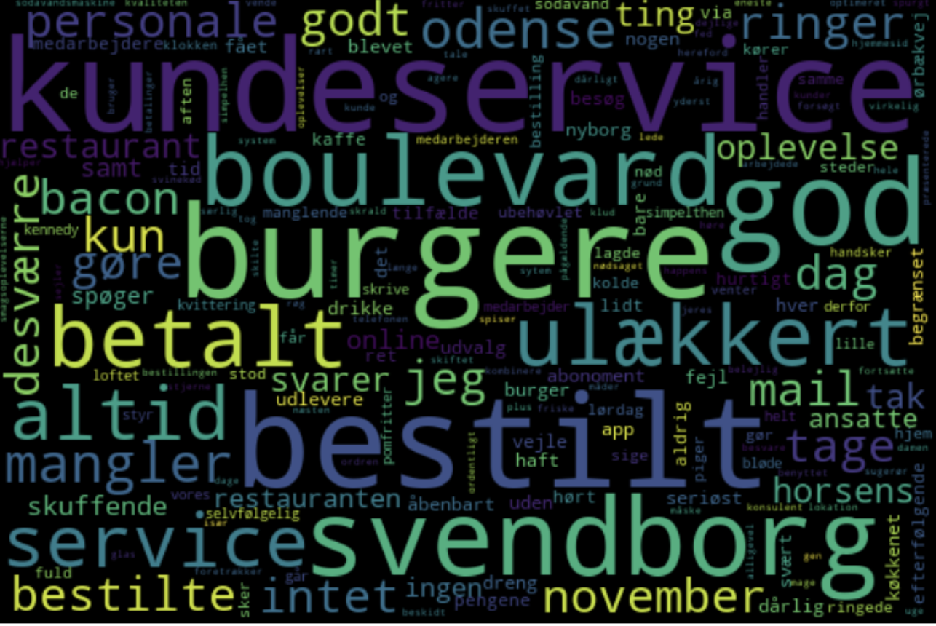
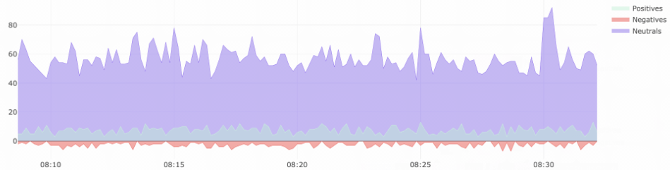
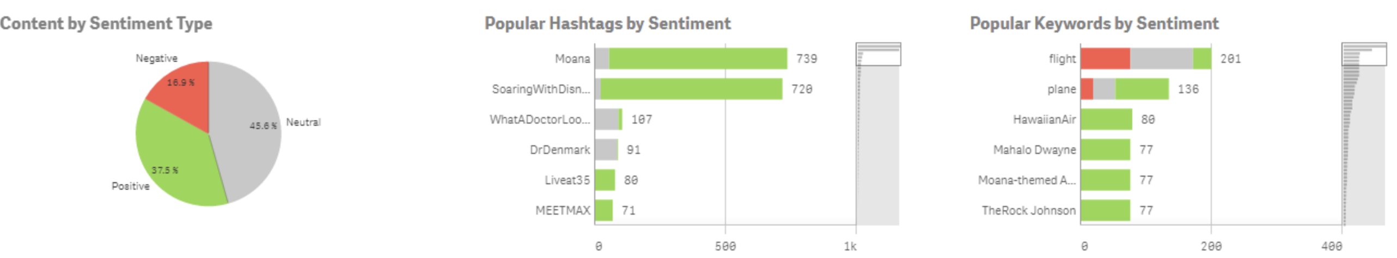
POC Text-Sentiment Analysis
BI & IT department
Select Restaurant
Date Range
2022-01-01
2022-12-01
Reviews
40
Positiv Reviews
20%
Negativ Reviews
35%
Neutral Reviews
45%

